Slide 1

Blockchain ⊂ Decentralization
Arquitecturas Descentralizadas, Componentes y Problemas a Resolver
Notes:
Blockchain ⊂ Decentralization
“No todo lo decentralizado es una blockchain”

Slide 2
¡Pormenores!
Notes:
Exposicion del concepto “Blockchain ⊂ Decentralization”
Estamos muy focalizados en blockchain y tenemos que expandir nuestro foco hacia la decentralizacion que incluye mas conceptos que el de blockchain.
Entre esos conceptos esta el de P2P
Pero tenemos que tener claro que hay limitantes para decentralizar todo

Slide 3
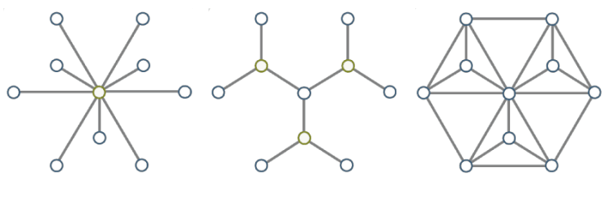
Topologias
Centralizada
Distribuida
Descentralizada
Notes:
Primero lo basico:
Centralized
Federated or Distributed
Decentralized
Consensus / Blockchain (between n participants)
Combinations
Definir los conceptos

Slide 4
Notes:
Hablar de las dimensiones de estos aspectos.
Es centralizado, distribuido o federado, descentralizado, combinaciones desde estas dimensiones:
Funcionalmente/Tecnicamente
Ownership
Governance
Vitalik habla de las siguientes dimensiones:
Arquitectura
Politica
Logica
Dice que las blockchains son politicamente descentralizadas (nadie las controla), arquitecturalmente descentralizadas (no hay un punto central de fallas) PERO son logicamente centralizadas porque actua como una computadora unica con un estado global.

Slide 5
Razones para Descentralizar
Consenso
Tolerancia a fallas
Resistencia a ataques
Resistencia a colusiones
Negocio
Quitar mediadores
Resistencia a censura
Mayor transparencia
Convertir un negocio en un mercado
Es más fácil conseguir plata de esta manera...
Notes:
Ejemplo de OpenBazaar para censura.

Slide 6
Evaluando Aplicaciones y Protocolos
Aplicación o Protocolo | Centralizado | Distribuido | Descentralizado | Hibrido
Facebook | ? | ? | ? | ?
SMTP/E-Mail | ? | ? | ? | ?
DNS | ? | ? | ? | ?
Napster | ? | ? | ? | ?
Torrent | ? | ? | ? | ?
OpenBazaar | ? | ? | ? | ?
Notes:
Hacer una grilla, mostrando protocolos o apps y con espacios en blanco donde la gente tiene que pensar si es centralizado, federado o distribuido, decentralizado, o combinaciones.
Nombrar:
Facebook
SMTP/E-Mail
DNS
Napster
Torrent

Slide 7
Resultados Fundamentales y Limitantes
Computación
Limitación en la performance de las blockchains (BFT)
Teorema CAP
Buscador descentralizado y ranking de resultados
Teoría de las Organizaciones
Coase, Ronald H. The nature of the firm. 1937
Galbraith, John Kenneth. The new industrial state. 1967.
Boyd, R., & Richerson, P. J. Solving the puzzle of human cooperation. Evolution and culture. 2006.
Notes:
Constraints / Resultados Fuertes
Computer Science
Limitacion en la performance de las blockchains/BFT
CAP Theorem: states that it is impossible for a distributed data store to simultaneously provide more than two out of the following three guarantees:
Consistency: Every read receives the most recent write or an error
Availability: Every request receives a (non-error) response – without guarantee that it contains the most recent write
Partition tolerance: The system continues to operate despite an arbitrary number of messages being dropped (or delayed) by the network between nodes
Problema del Search y el ranking de los resultados
Indistinguibilidad del fraude?
Organizational Theory / Cooperation
Theory of the Firm by Ronald Coase (Nature of the Firm [1937])
The Tyranny of Structurelessness [1971] https://en.wikipedia.org/wiki/The_Tyranny_of_Structurelessness
The New Industrial State[1967] by Kenneth Galbraith
Solving the Problem of Human Cooperation
------- o ---------
Writing in his 1967 classic, The New Industrial State, Galbraith observed that large companies were growing ever larger, capturing the central position in American life.
These giants had overcome laws of supply and demand by investing in big, long-term research and development projects, which could not easily be replicated by smaller competitors.
“The great corporations,” he wrote, “were not corner grocery stores grown large...”
“...They were different.”
--------- o ----------
THEORY OF THE FIRM
In simplified terms, the theory of the firm aims to answer these questions:
Existence. Why do firms emerge? Why are not all transactions in the economy mediated over the market?
Boundaries. Why is the boundary between firms and the market located exactly there with relation to size and output variety? Which transactions are performed internally and which are negotiated on the market?
Organization. Why are firms structured in such a specific way, for example as to hierarchy or decentralization? What is the interplay of formal and informal relationships?
Heterogeneity of firm actions/performances. What drives different actions and performances of firms?
Evidence. What tests are there for respective theories of the firm
“According to Ronald Coase, people begin to organise their production in firms when the transaction cost of coordinating production through the market exchange, given imperfect information, is greater than within the firm.”

Slide 8
Componentes Recurrentes
P2P
Listings
Mensajeria
Identidad
Custodia
Almacenamiento
Exchange
Marketplace
Workflow
Microtransacciones
Incentivos
Disputas
Detección de fraudes
Proof of existence
Token
Stake
Escrow
DAO y sus variantes
Oracle
Offchain
Computación descentralizada
Otras Blockchains
Notes:
P2P: dar ejemplo de multisig
Listing: dar el ejemplo de openbazaar

Slide 9
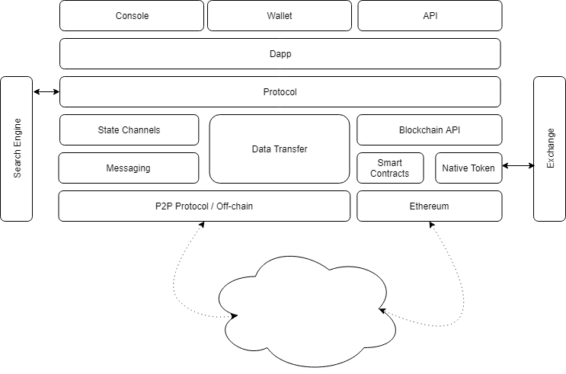
Arquitectura en Construcción

Slide 10
¿Discutimos?

